Slide 1


Guatemala SQL Server user group
May 2019
Notes:
Speaker: Eduardo

Slide 2

Upcoming Virtual Group Webinars
Virtual Group | Meeting Date | Time | Topic | Website
Database Administration | May 30, 2019 | 16:00 – 17:00 (UTC) | Modernizing your SQL Infrastructure with Intel® Technologies in 2019 - Jake Smith | dba.pass.org
Cloud | May 30, 2019 | 17:00 – 18:00 (UTC) | High Availability and Azure - Scaling SQL Server to the Cloud - Matt Gordon | cloud.pass.org
DBA Fundamentals | Jun 4, 2019 | 16:00 – 17:00 (UTC) | Journey to the Cloud with Azure Database Migration Service - Warner Chaves | fundamentals.pass.org
Cloud | Jun 4, 2019 | 17:00 – 18:00 (UTC) | Instant insights, automation and action with Power BI, Power Apps, Flow and Azure Machine Learning - Anthony Bulk | cloud.pass.org
Notes:
Speaker: Eduardo Pivaral

Slide 3
Upcoming Virtual Group Webinars
Virtual Group | Meeting Date | Time | Topic | Website
Professional Development | Jun 6, 2019 | 16:00 – 17:00 (UTC) | How to build a book of business for consultants - Blythe Morrow | professionaldevelopment. pass.org
Cloud | Jun 6, 2019 | 17:00 – 18:00 (UTC) | Don't Cross the Streams! A Closer Look at Azure Stream Analytics - Johan Ludvig Brattås | cloud.pass.org
Cloud | Jun 11, 2019 | 17:00 – 18:00 (UTC) | Azure SQL Containers - Andrew Pruski | cloud.pass.org
Data Architecture | Jun 12, 2019 | 18:00 – 19:00 (UTC) | Migration to Azure Datawarehouse: Performance Tips & Techniques - Amir Baig | dataarch.pass.org
Notes:
Speaker: Eduardo Pivaral

Slide 4
Upcoming Virtual Group Webinars
Virtual Group | Meeting Date | Time | Topic | Website
Business Analytics | Jun 18, 2019 | 17:00 – 18:00 (UTC) | Power BI Streaming Datasets with Microsoft Flow - Devin Knight | bavc.pass.org
Cloud | Jun 18, 2019 | 17:00 – 18:00 (UTC) | Introduction to Azure Data Lake - Oskari Heikkinen | cloud.pass.org
Women in Technology | Jun 19, 2019 | 16:00 – 17:00 (UTC) | What is DevOps and Why Should DBAs Care? - Kathi Kellenberger | wit.pass.org
Cloud | Jun 20, 2019 | 17:00 – 18:00 (UTC) | Continuous Integration and Delivery (CI/CD) in Azure Data Factory - Rayis Imayev | cloud.pass.org
Notes:
Speaker: Eduardo Pivaral

Slide 5

Upcoming SQLSaturdays
APAC
LATAM
#838 Brisbane – Jun 01, 2019
#831 South Island NZ – Jun 08, 2019
#865 Melbourne – Jun 15, 2019
#844 Belo Horizonte – May 18, 2019
#876 Santo Domingo – May 25, 2019
#833 Mexico – Jun 08, 2019
#783 Costa Rica-BI – Jun 15, 2019
#834 Caxias do Sul – Jun 22, 2019
EMEA
US/Canada
#871 Sardegna – May 18, 2019
#857 Kyiv – May 18, 2019
#856 Rheinland – May 25, 2019
#874 Timisoara – Jun 08, 2019
#872 Paris – Jun 15, 2019
#858 Athens – Jun 15, 2019
#853 Plovdiv – Jun 22, 2019
#862 Cork – Jun 29, 2019
#845 Atlanta – May 18, 2019
#841 Dallas – Jun 01, 2019
#864 South Florida – Jun 08, 2019
#861 Columbus – Jun 08, 2019
#839 Virginia Beach – Jun 08, 2019
#891 Los Angeles – Jun 15, 2019
#882 Iowa City – Jun 22, 2019
#881 Chattanooga – Jun 22, 2019
#884 Pensacola – Jun 29, 2019
Notes:
Speaker: Eduardo Pivaral

Slide 6




Tech news
Latest Product releases
SQL Server 2019 CTP 3.0 – Download it here!
CU15 for SQL Server 2016 Service Pack 1 - here
CU7 for SQL Server 2016 Service Pack 2 - here
CU15 for SQL Server 2017 – here
Azure data Studio May release – Download it here!
Visual Studio 2019 16.1 (includes SSDT) – Download it here!
PowerBI May release – Download it here!
Notes:
Speaker: Eduardo Pivaral

Slide 7
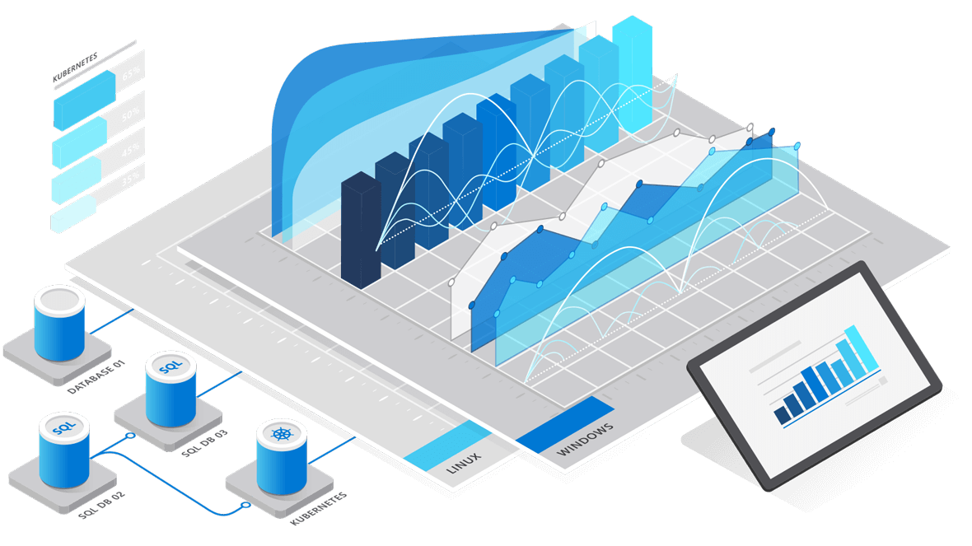
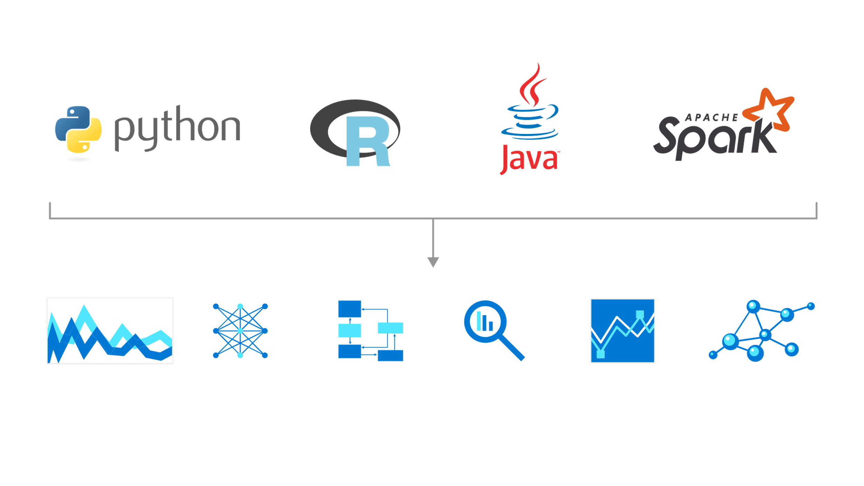
Azure SQL Database Edge
Running on ARM and Intel architecture
Tool for edge computing combines capabilities as data streaming and time series with in-database machine learning and graph features.
Develop your application once and deploy across the edge, your datacenter or Azure.
Currently on private preview
More information here:
https://azure.microsoft.com/en-us/services/sql-database-edge/
Notes:
Speaker: Eduardo Pivaral

Slide 8


Tech news
Event News
Microsoft Build 2019 – Recorded sessions here!
Event dedicated to inspiration, learnings, and innovation around the latest developer tools and tech.
RedHat Summit 2019 – Sessions here!
On this event we had more insight about SQL Server product integration into Linux
Notes:
Speaker: Eduardo Pivaral & Carlos Robles

Slide 9
Call for speakers
Want to participate as speaker in the next Guatemala's SQL Server User Group meeting? Just fill out the online form with a brief description of your session here:
https://gtssug.pass.org/en-us/sessionsubmission.aspx
Notes:
Speaker: Eduardo Pivaral

Slide 10

Tell us what you think:
Notes:
Speaker: Eduardo Pivaral

Slide 11





Follow us
Sign up for a free membership today at:
GTSSUG.PASS.org
#SQLPassGT @gtssug
Notes:
Speaker: Eduardo Pivaral

Slide 12


Connect with PASS
Sign up for a free membership today at:
PASS.org
#sqlpass @sqlpass
@passcommunity
Notes:
Speaker: Eduardo Pivaral

Slide 13
Notes:
Speaker: Eduardo Pivaral

Slide 14


Thanks to our sponsors!
Want to become a sponsor? Send an email to: gtssug@pass.org
Notes:
Speaker: Eduardo Pivaral

Slide 15



GTSSUG ACADEMYon Season
Próximo Evento:
Universidad Mariano Gálvez
Fecha: Jueves 30 de Mayo Lugar: Salón J Hora: 07:30PM
Platform event on May 9.
Notes:
Speaker: Carlos Lopez & Christian Araujo

Slide 16

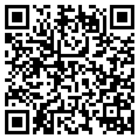


It’s SQL Server Migration Season
End of support for SQL Server 2008 is fast approaching so it’s time to take flight and build your migration plan.
To guide you through this journey, PASS, Microsoft, and Intel have teamed up for a series of expert-led events, giving you all the tools you need to get to your final destination – a modern data platform.
Register Now
https://bit.ly/2WoPSpV
Notes:
Speaker: Carlos Robles & Christian Araujo

